Slide 1
How to Play with Witness Encryption without the Theoretical Hassle
(Or: weak forms of WE and good stuff we can get from them) Matteo Campanelli Protocol Labs
matteo@protocol.ai https://binarywhales.com
Also based on the recent eprint:
(w/ Dario Fiore & Hamidreza Khoshaklagh)
14th April 2023 @ IISc
https://ia.cr/2022/1510

Slide 2
Advanced Forms of Encryption
e.g., the Riemann Hypothesis
pk
e.g., a proof for the Riemann Hypothesis
sk
sk
Public Key Encryption (PKE)
Witness Encryption (WE)

Slide 3
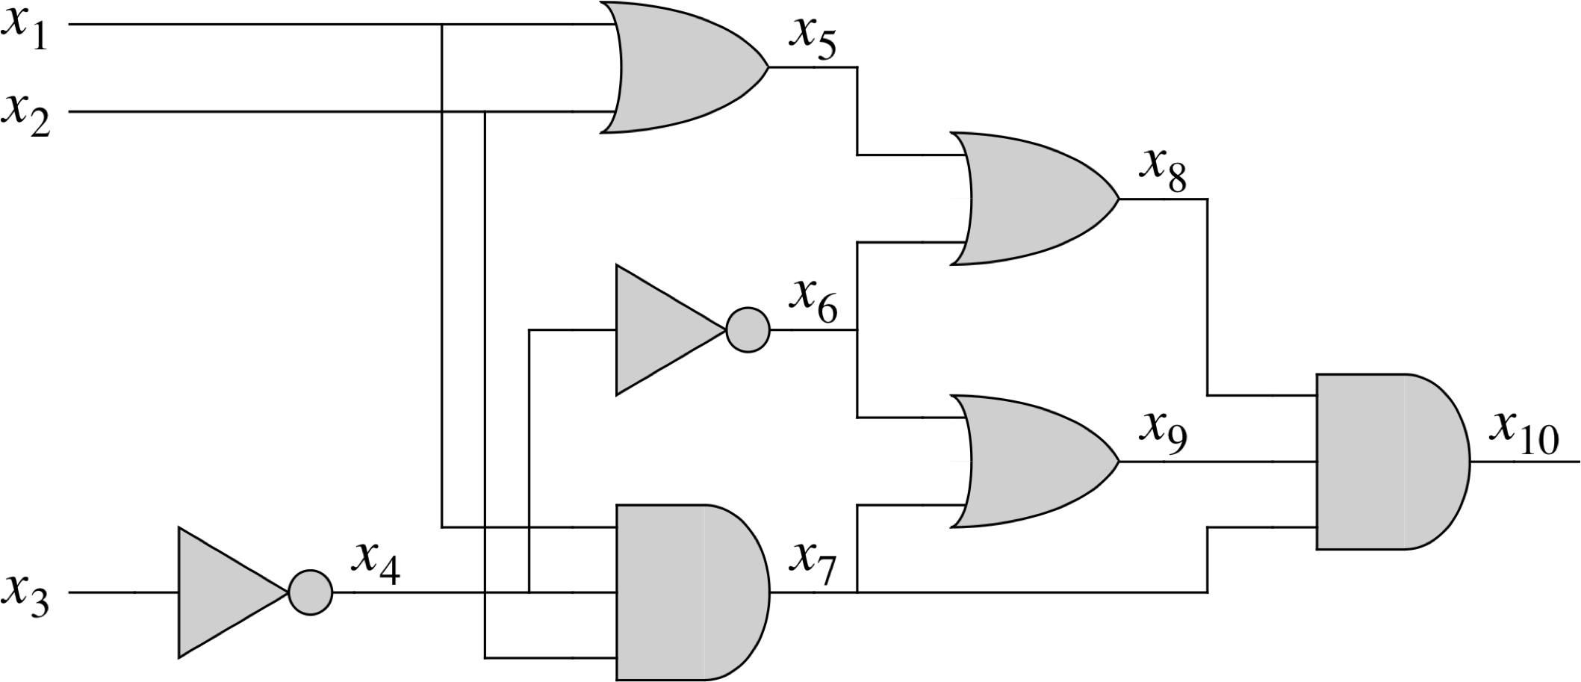
“Witness”?
Remember the complexity class NP?
Witness Encryption (WE)
A statement $C$ for Circuit-SAT
$C∈$ Circuit-SAT $↔$ // C is in the language iff $∃ \vec{x}: C\left(\vec{x}\right)=1$ // there is a “witness” for C
From [GGSW13]

Slide 4
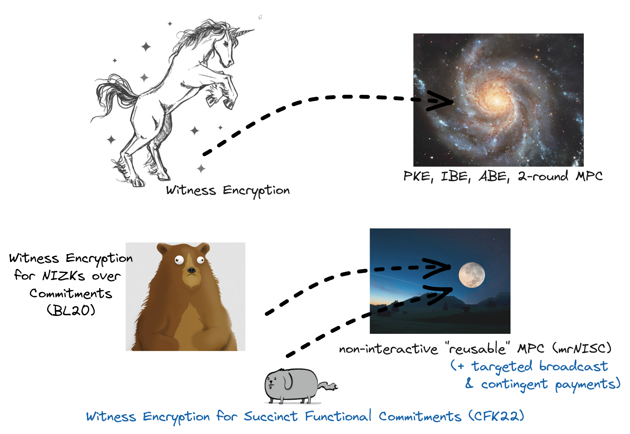
This Talk in One Slide
Problem: Hard-ish to find this creature in (cryptographic) nature for now
Solution? Could we bioengineer a less powerful “creature” that achieves similar results?
better communication/efficiency (+ can catch frisbee if trained)
Earthling animal pics from: The Oatmeal

Slide 5
Plan
3
Groth-Sahai NIZKs +
=
WE for linear languages
2
1
4
5

Slide 6
A Closer Look at WE and Applications

Slide 7
WE: Model
NP Relation (e.g. circuit satisfiability)
NB: Security says something only for “puzzles without solutions”!
Syntax
Syntax
$PKE.KG\left(1λ\right)→(sk,pk)$
$PKE.Enc\left(pk,m\right)→ct$
$PKE.Dec\left(sk,ct\right)→m$
$WE.Enc\left(R, x,m\right)→ct$
$WE.Dec\left(w,ct\right)→m$
Language associated with R (e.g. all the circuits that are satisfiable)
Security
Security
$$∀ relation R \\ ∀x∉L_{R}$$
$$WE.Enc\left(R,x, 0\right)≈WE.Enc\left(R,x,1\right)$$
$$PKE.Enc\left(pk,0\right)≈PKE.Enc\left(pk,1\right)$$

Slide 8
PKE from WE (and PRG)
Given a PRG G
Sample random seed s as sk
Use as pk an evaluation of the PRG t:= G(s)
Why does this work?
Recall: Goal Security for PKE:
$$PKE.Enc\left(pk,0\right)≈PKE.Enc\left(pk,1\right)$$
Define relation $R_{G}\left(t;s\right) ≔\text{"}\text{G}\text{(}\text{s}\text{) = }\text{t}\text{" }$
PKE.Enc(t, m):
$WE.Enc\left(R_{G}, t,m\right)→ct$
Decryption is straightforward
$$Enc\left(R_{G}, t,0\right)≈Enc\left(R_{G}, r, 0\right)≈Enc\left(R_{G}, r,1\right)≈Enc\left(R_{G}, t,1\right)$$
(above t is from the PRG and r is random)
Hybrids:
PRG sec
WE security

Slide 9
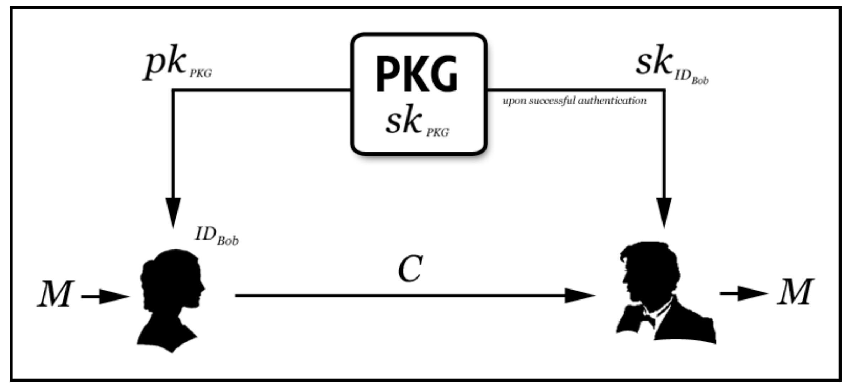
WE => IBE
IBE (Identity-Based Encryption)
Credit for image: Carl Youngblood

Slide 10
WE => ABE (Attribute-Based Encryption)
Motivating scenario: targeted broadcast
msk
sk
Subscription: Iranian movies
$$ABE.Enc\left(\begin{aligned}movie, \\ policy ≔"Iranian horror"\end{aligned}\right)$$
sk
Subscription: “anything with Bob De Niro”
Iranian horror
sk
Subscription: romantic comedies ¦¦ horror

Slide 11
Brush up on MPC
$$F(D_{1},D_{2},…, D_{N})$$
D₂
D₁
D₃
…
In general: round complexity can be relatively high.
D_{N}

Slide 12
WE => 2-round MPC [GSL15]
Messages at round 1
Messages at round 1
D₁
D₁
Messages at round 2
…
WE
…
…
Messages at round 2
D_{N}
Messages at round T
D_{N}
$$Eval\left(transcript[1..T]\right)→$$ $F(D_{1},D_{2},…, D_{N})$
$$Eval\left(transcript\left[1,2\right]\right)→$$
$$F(D_{1},D_{2},…, D_{N})$$

Slide 13
WE => mrNISC (MPC that is reusable & Non-Interactive ) [BL20]
WE actually implies an even stronger type of MPC
We can obtain this by basically using the same approach
(We will see later that full-blown WE, however, is not even necessary for this)

Slide 14
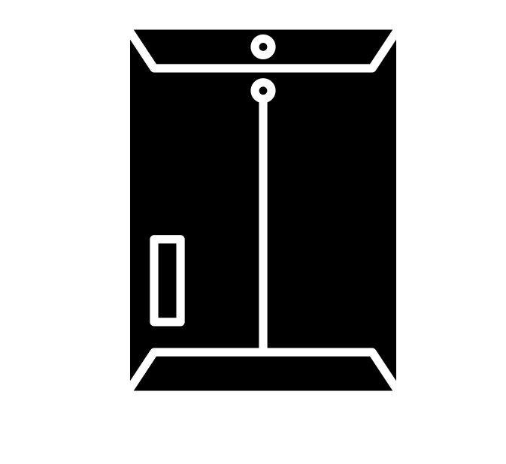
WE => mrNISC (MPC that is reusable & Non-Interactive ) [BL20]
Commit(D₁)
…
C₁
C_{N}
D₁
(Reusable)
Offline stage
…
Commit(D_{N})
D_{N}
A bulletin board (e.g., a blockchain)

Slide 15
WE => mrNISC (MPC that is reusable & Non-Interactive ) [BL20]
…
D₂
C₁
C₂
C₄
C₅
…
Online stage
$$Eval(C_{2,4,5},m_{2,4,5})→$$ $F(D_{2},D_{4}{,D}_{5})$
m₂
$$F(D_{2},D_{4}{,D}_{5})$$
m₄
D₄
m₅
D₅
A bulletin board (e.g., a blockchain)

Slide 16
Breather: questions so far?

Slide 17
WE is a Hard Problem

Slide 18
How can we build WE?
Next slides: common approaches to build WE and limitations in their requirements (assumptions and efficiency)

Slide 19
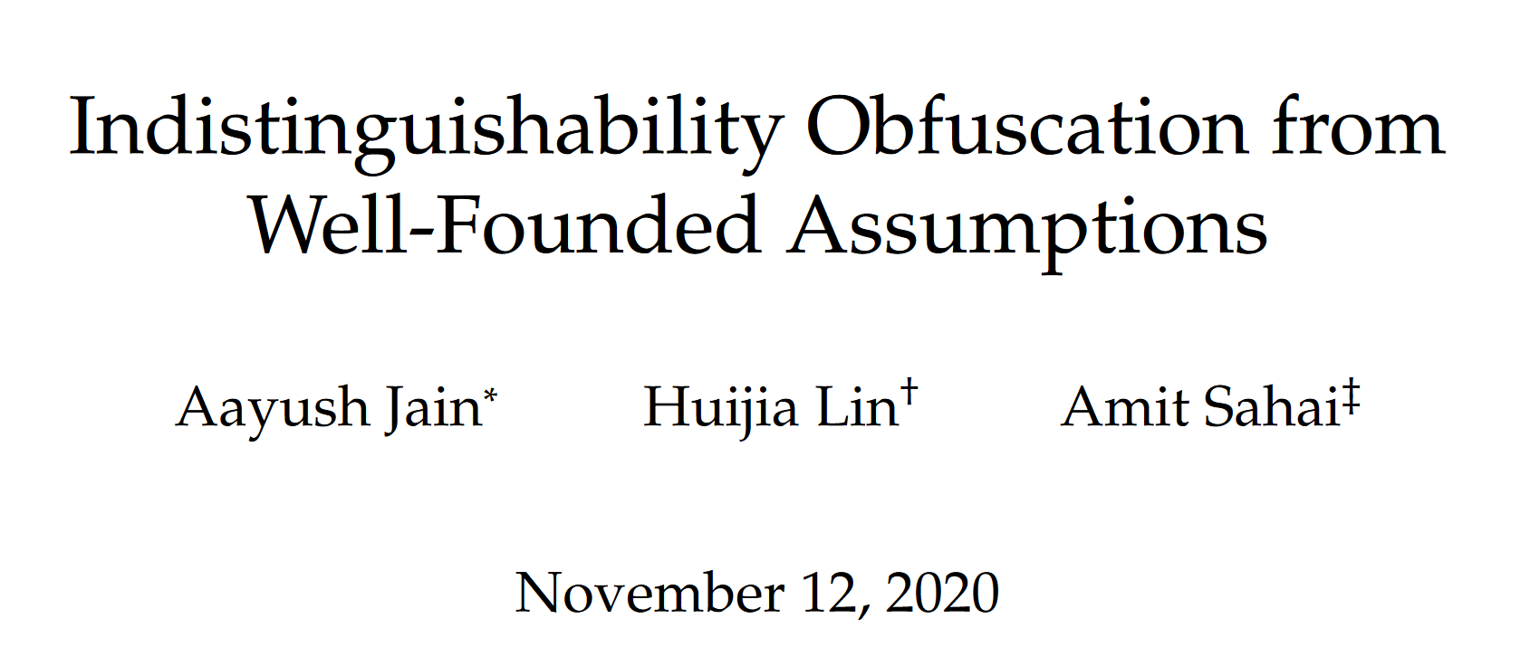
WE from iO (indistinguishability obfuscation)
Obfuscation of a program P => Obf(P), a program like P but that “hides the inner workings of P”*
To encrypt bit b with puzzle consider program P:
Could we build iO till very recently?
P( ):
if is the witness for then:
return b
else return $⊥$
Ciphertext $ct$ is the obfuscation of P
What do we do to decrypt?
We run $ct$( )
* Highly simplified and inaccurate definition for iO, but that should give the idea

Slide 20
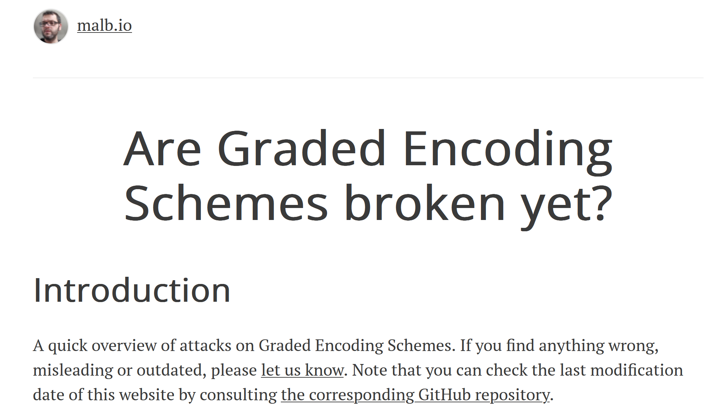
WE from Multilinear Maps (GGHR)

Slide 21
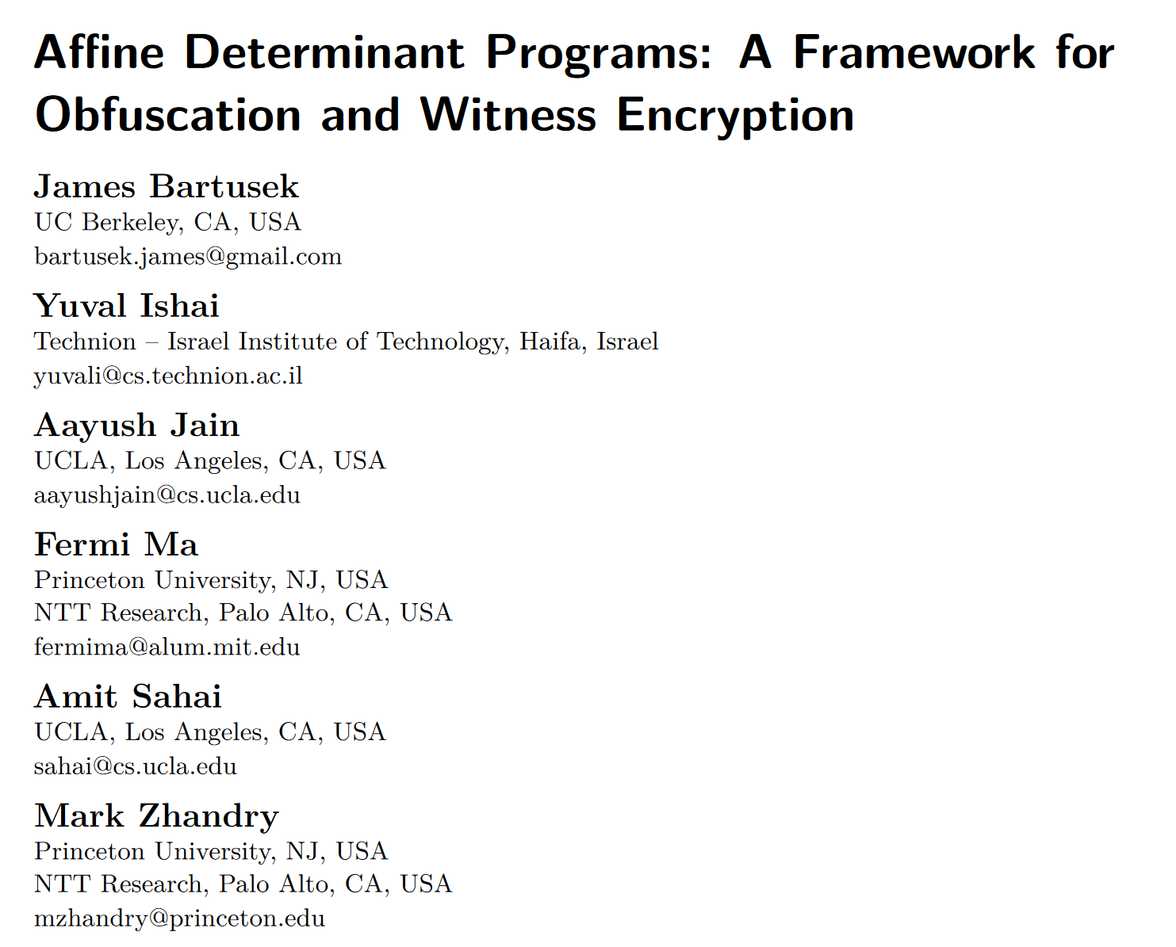
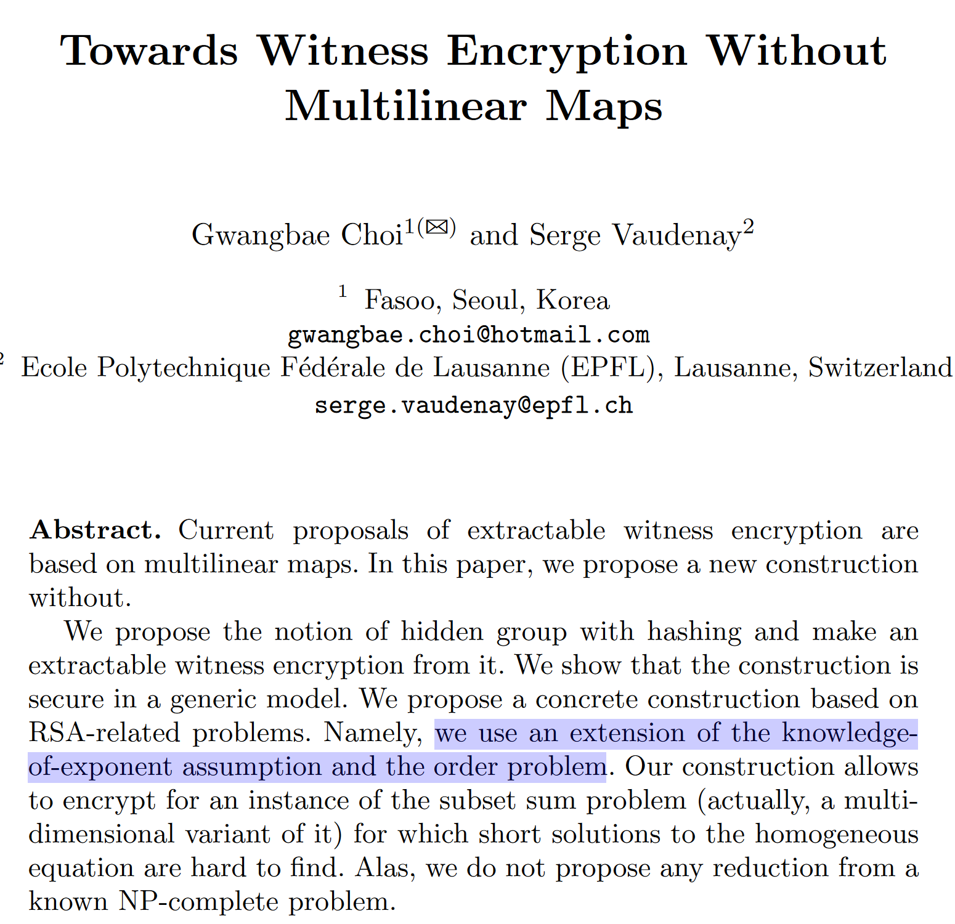
WE from still unexplored algebraic structures

Slide 22
WE from other complexity-theoretic conjectures + Generic Group Model
Non trivial strengthening of what is known on the GapMDP problem

Slide 23
Some hope?

Slide 24
Summary so far
So far: (general-purpose) WE is a hard problem
More direct constructions are not on a secure ground yet
Indirect approaches may be paying in efficiency / requiring more than what we need
Next: But can we achieve weaker WE-s and retain some of the applications we saw so far?
We will look in particular at mrNISC (reusable non-interactive MPC)
1) [BL20] and ”WE for NIZKs over commitments”
2) [CFK22] and ”WE for succinct functional commitments”
better efficiency plus other applications

Slide 25
[BL20]: WE for NIZKs over Commitments

Slide 26
… “for NIZKs”? … “Over commitments”?
One thing at the time; let’s have a:
Brush up over NIZKs and commitments
Look at WE in this setting
Look at how we build them (from standard assumptions)
Look at how they come up in MPC round collapse
Unfortunately too messy; You’ll have to take my word for it.

Slide 27
NIZK: Non-Interactive Zero-Knowledge Proofs
$$Π$$
Prover
Verifier
Proof convinces Verifier that there exists a solution to the puzzle (soundness) without leaking it (zero-knowledge).
Soundness more in detail: if there exists no solution then there exists no proof $π$ that can convince a verifier (with significant probability).

Slide 28
NIZKs over Commitments*
alleged commitment to
(perfectly binding)
C
$$Π$$
Opening for commitment C
Prover
Verifier
Proof convinces Verifier that there exists a solution to the puzzle AND and opening such that + =>
Note:
Perfect binding is crucial if we are using proofs (rather than arguments)
Commitment and proof can be as large as
* This is also basically a CP-NIZK in LegoSNARK lingo [CFQ19]

Slide 29
WE for NIZKs over commitments
NB: These two definitions are qualitatively different: we go from security that deals with non-determinism to one that deals with determinism!
Standard WE
WE for NIZK over commitments
Syntax
Syntax
$WE.Enc\left( ,m\right)→ct$
$WE.Dec\left( ,ct\right)→m$
WE.Com( ) $→$
$WE.Enc\left( , ,m\right)→ct$
$WE.Dec\left( π ,ct\right)→m$
Recall NIZK over commitments!
Proof convinces Verifier that there exists a solution to the puzzle AND and opening such that + =>
Security
Security
Let ct be a ciphertext encrypted w.r.t. property P and commitment cm = Com(D), if P(D) is false then the ciphertext leaks nothing about the plaintext.
$$∀ puzzle without solution$$
$$WE.Enc\left( , 0\right)≈WE.Enc\left( ,1\right)$$

Slide 30
Building WE for NIZKs over commitments from pairings
Groth-Sahai NIZKs +
Decryption we want to achieve:
$$WE.Dec\left( π ,ct\right)→m$$
In a sense the proof $π$is the “solution to the puzzle” here.
=
What puzzle? The verification algorithm of the NIZK
WE for linear languages
Key observation of [BL20]:
There exists WE for very simple languages (linear languages)
Implied by Hash Proof Systems (aka smooth projective hash functions) [ABP15]
Groth-Sahai has linear verification for certain (restricted) classes of computations
This can be bootstrapped to all P through randomized encodings
Also, this suffices for round collapsing and to obtain mrNISC!

Slide 31
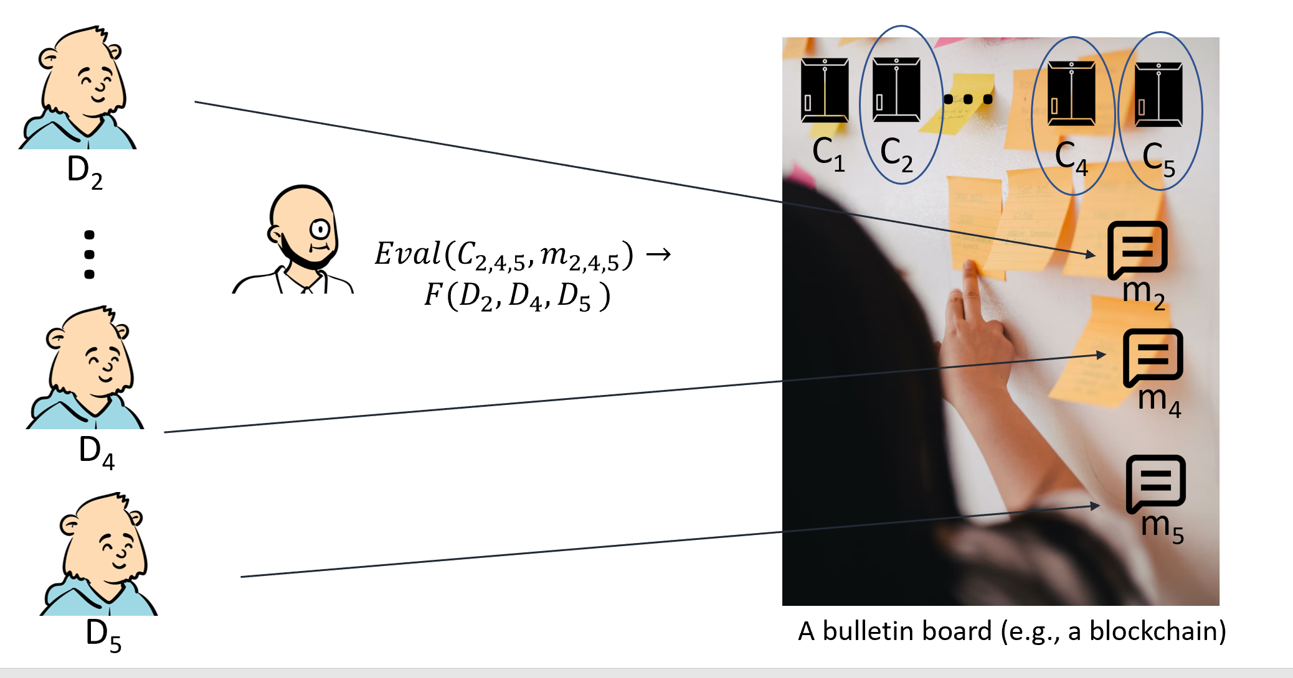
How Collapse to two Rounds Works

Slide 32
[CFK22]: WE for Succinct Functional Commitments

Slide 33
Efficiency in [BL20]
Commitments are large (as large as the data)
And they may have to go on chain ideally
Decryption runs in the size of the NIZK $π$ (as large as the property proved over the data)
Can we achieve similar results with succinct commitments and decryption?

Slide 34
(Strawman) Succinct commitments + SNARKs
Recall:
the commitments in [BL20] are perfectly binding, i.e. non-compressing
They use NIZKs proofs, that are also non-succinct
So, couldn’t we just switch to…:
succinct commitments (e.g. Pedersen)
And a succinct argument system, a SNARG or SNARK?
WE for NIZK over commitments
Syntax
WE.Com( ) $→$
$WE.Enc\left( , ,m\right)→ct$
$WE.Dec\left( π ,ct\right)→m$
Groth-Sahai NIZKs +
=
Not quite! Two problems with SNARG/K-s:
No linear verification [Groth16]
Require inherently stronger assumptions (in comparison [BL20] is in the standard model)
WE for linear languages

Slide 35
Our Solution: moving to Succinct Functional Commitments
alleged commitment to D
(computationally binding)
$$F(⋅)$$
C
D
$$Π, y$$
Opening for commitment C
Prover
Verifier
Proof convinces Verifier that $F(D) = y$

Slide 36
Why Succinct Functional Commitments?
There exist constructions from falsifiable assumptions (as opposed to SNARG/K-s)
Libert et al. 2016, Lipmaa and Pavlyk 2020, Catalano et al. 2022,…
There exist constructions with linear verification for several classes of computation:
Inner products (Libert et al. 2016)
Sparse polynomials (Lipmaa and Pavlyk 2020)

Slide 37
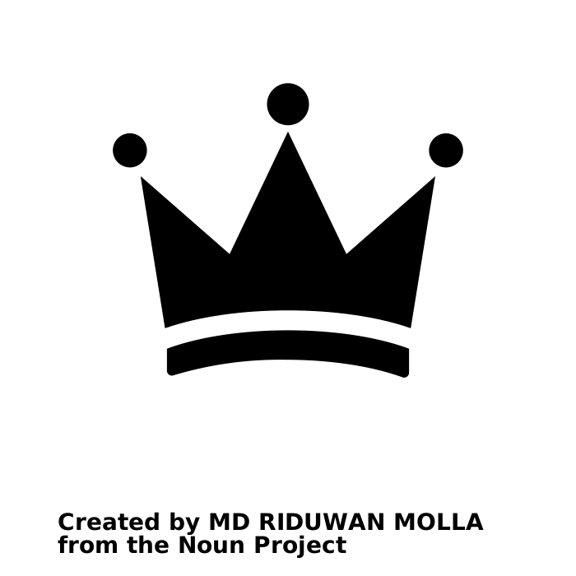
Our Contributions
New definitions and constructions
We adapt the recipe of [BL20] to the succinct setting
This requires additional care and new tools
We show how to use our notion to build mrNISC
We show that one may obtain mrNISC through round collapse of Beaver triples-based techniques (assuming slightly more powerful sFC)
Additional application settings
Targeted broadcast
Contingent payments over commitments
Succinct Functional Commitment with linear verification
+
+
=
Extractable Hash Proof system for linear languages

Slide 38
Summary
Weaker WE can still be useful (yet instantiatable)
Our work: techniques to add succinctness to “weak WE” with minimalistic theoretical requirements
Thanks!
Eprint at:
https://ia.cr/2022/1510

